Slide 1

Future Directions for Collection Development in Academic Research Libraries
Anne R. Kenney
Carl A. Kroch University Librarian
Academic Libraries Today: Our Future Is Now
The University of Hong Kong Libraries Centenary Anniversary Conference
Notes:
From Product to Process: 21st Century Collection Development

Slide 2
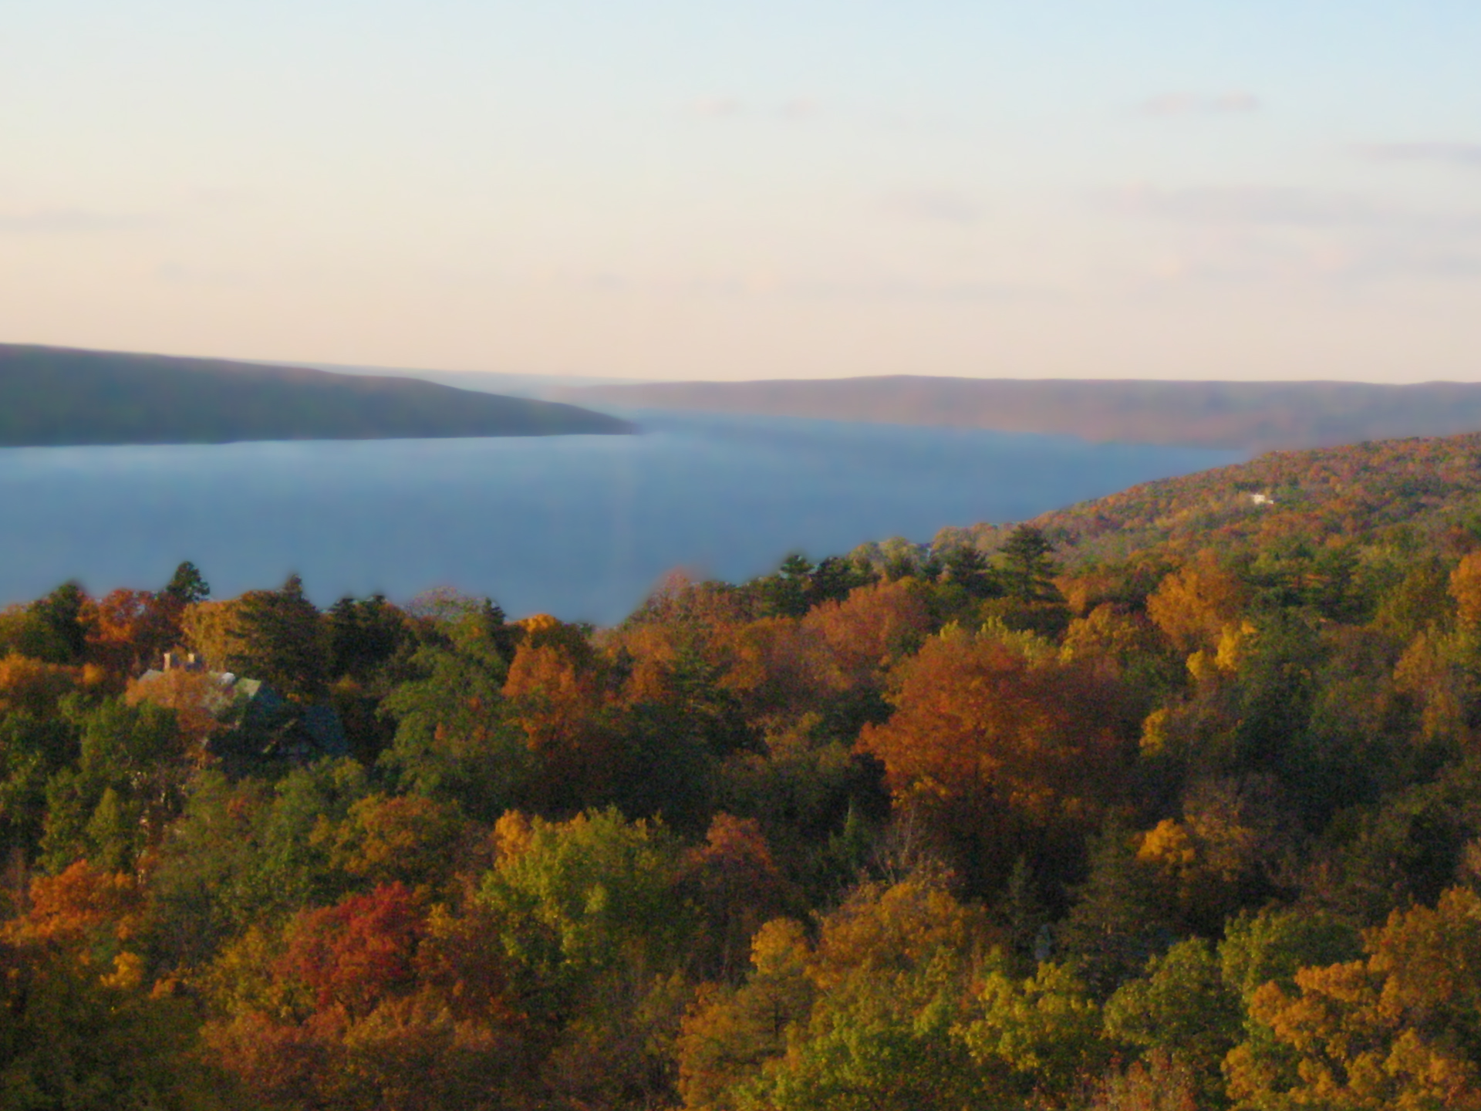
“Start here, go anywhere.”
~ a student

Slide 3
Basic Facts About Cornell

Slide 4
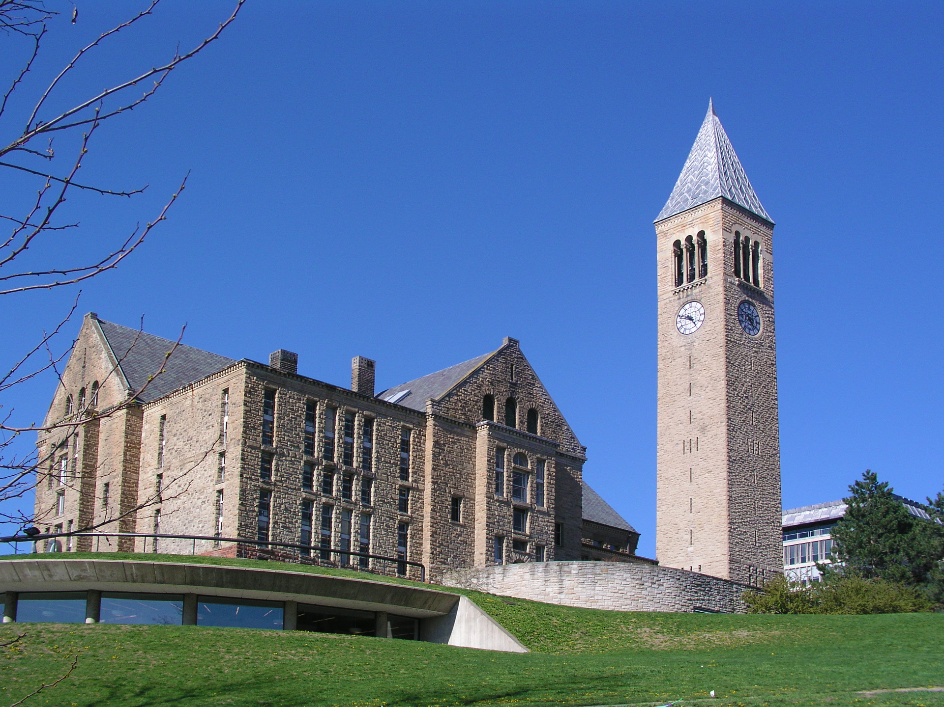
“Any study, anytime, anywhere.”
~ a student

Slide 5
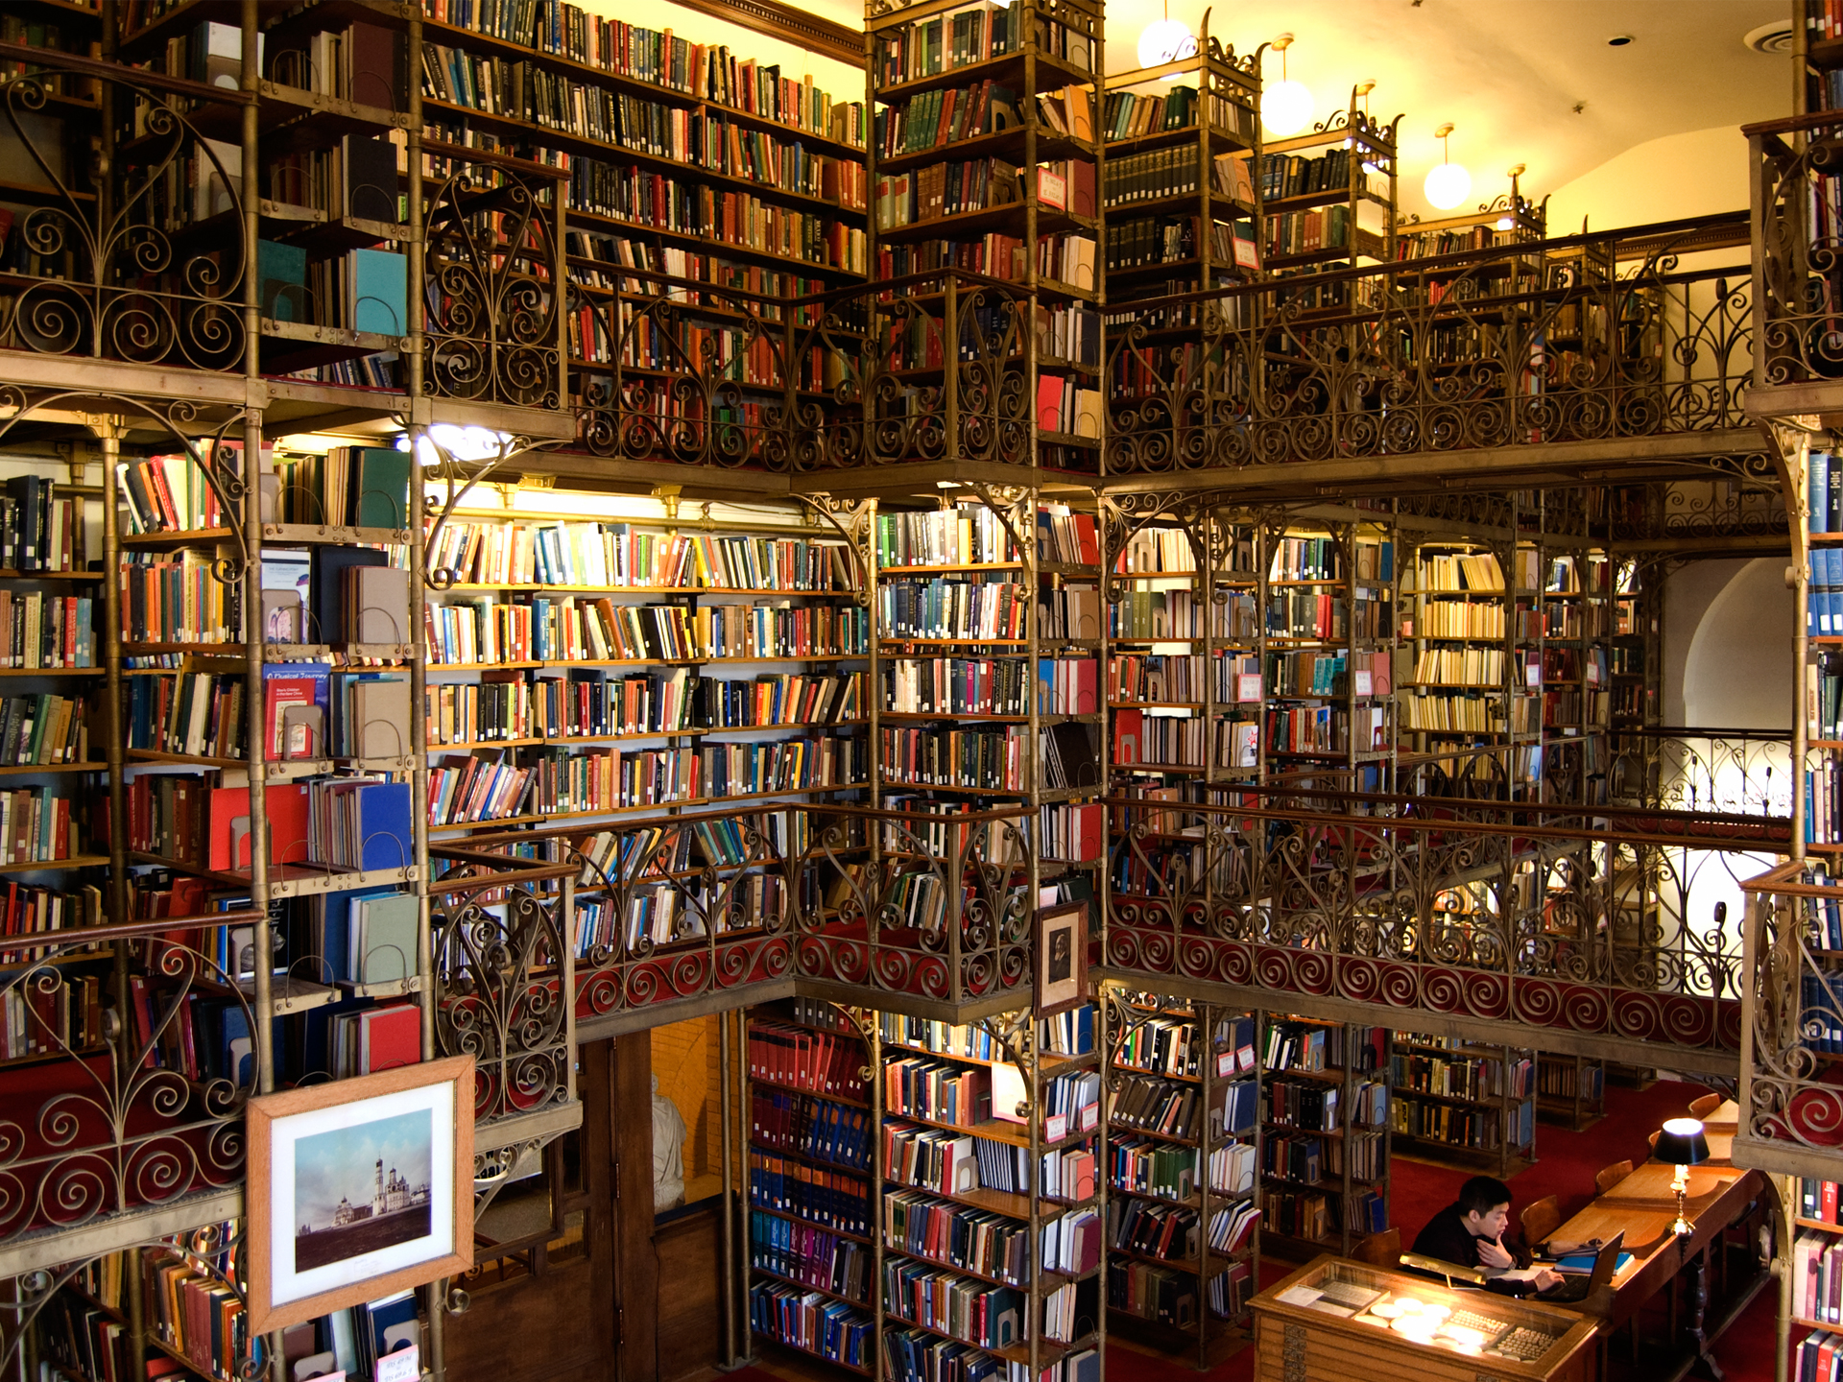
“Books are just the beginning.”
~ a student

Slide 6
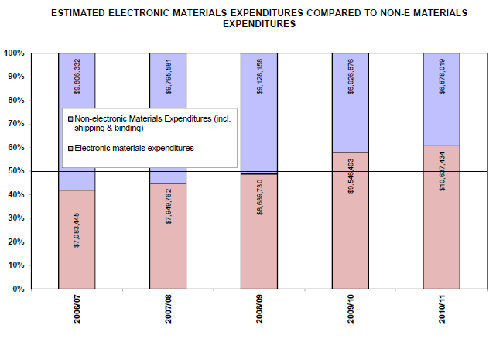
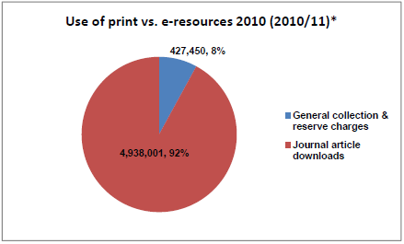
Basic Facts About the Library
Materials Expenditure
Collection Use

Slide 7
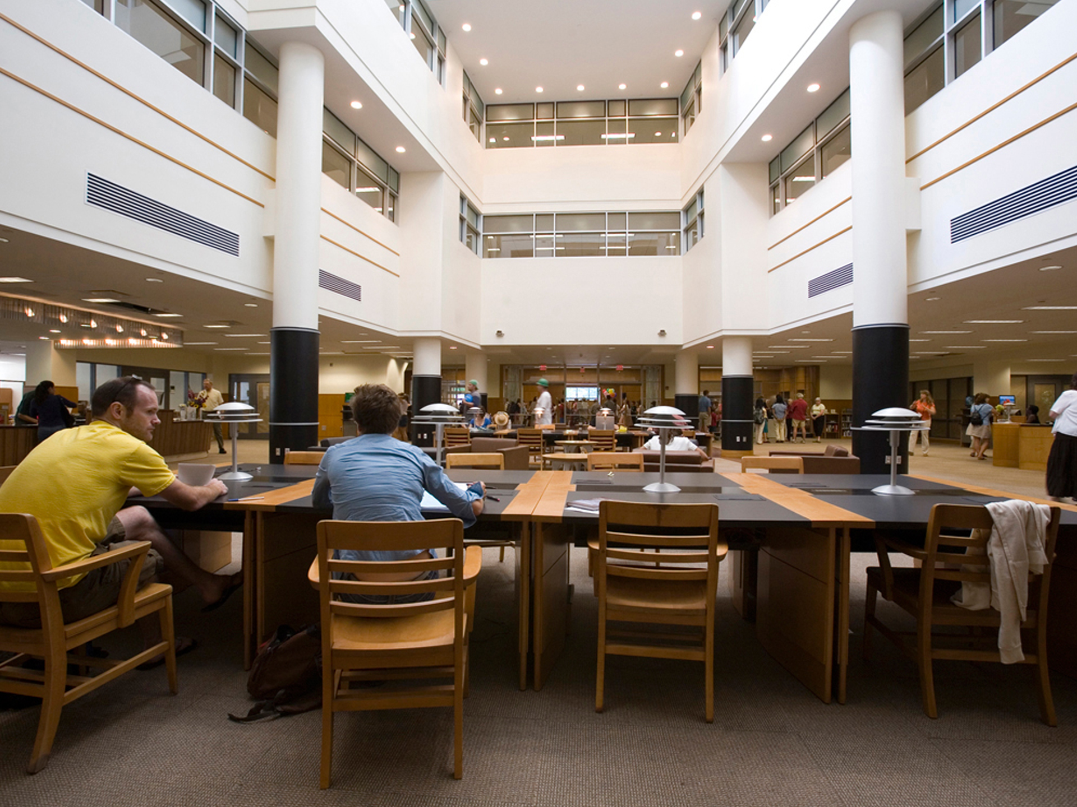
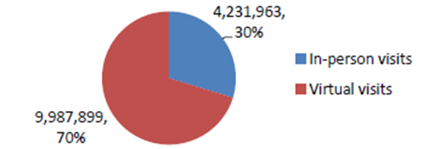
“Your intellectual home.”
~ a student

Slide 8
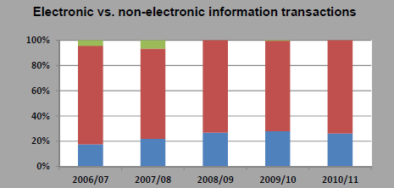
Basic Facts About the Library
Reference
Non-electronic transactions
Electronic transactions
Unknown

Slide 9
21st Century Research Collections
Worldwide economic crisis
Digital hegemony
Massive digitization
Beyond books and journals
Globalization of higher education
Changes in research, teaching, learning practices

Slide 10
From Product to Process
Encompassing local needs, shared investment, coordinated decisions
Engaging scholars, content providers, and policy makers
Adding value
From competition to deep collaboration
“In a networked world, local collections as ends in themselves make learning fragmentary and incomplete.” Rick Luce, 2011

Slide 11
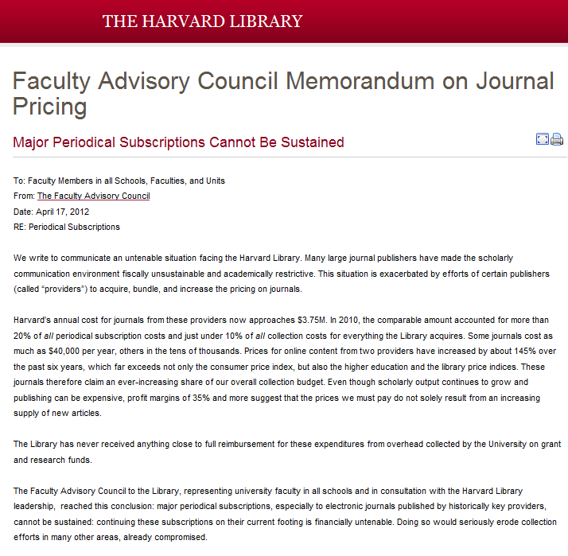
Publisher Relations
Responding to unrelenting price hikes
Sharing contract information
Scholar engagement

Slide 12
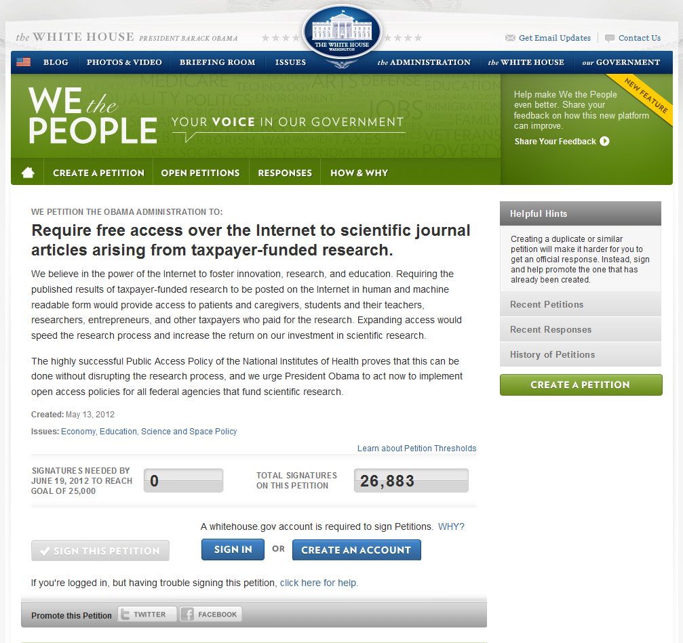
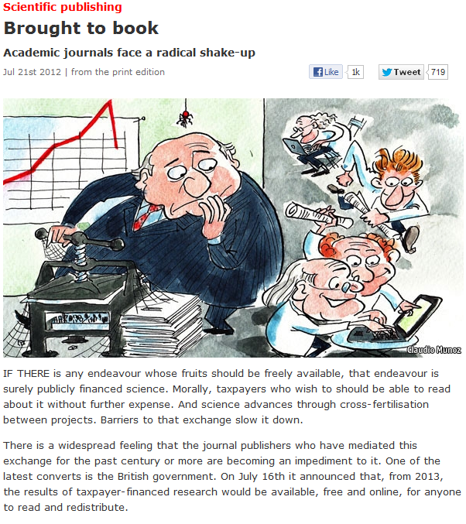
Open Access
Campus support for OA
Open access journals
Government requirements on publicly-funded research
Sustainability of model

Slide 13

Use Rights
Fair use in the digital world
  E-reserves
  E-lending
E-books
Protecting author rights
Asserting fair use
“Scanning books to preserve them and to construct an index is the kind of fair and creative use that copyright should favor.” Judge Baer on HathiTrust Law Suit

Slide 14
Selection Trends
Archiving web content
Patron driven acquisition
Use based decision making (Walker report) staffweb.library.cornell.edu/system/files/CollectionUsageTF_ReportFinal11-22-10.pdf
Building content via context and linkages
Collaborative collection building
Notes:
Patron Driven Book Approval Plans continue to grow for almost a year loaded records for ebooks in our catalog, now including records for print for sciences.
EMPS has been the leader in this effort at CUL and we have been able to offer our users many more e-books via the catalog than we were ever able to offer in a paper environment. We have put records for 1800 titles with 2010 and 2011 imprints for e-books from 11 publishers in the library catalog with a total price of well over $200,000 and our users have purchased 225 titles that has cost us about $27,000. We are looking to expand this program to reach other publishers and to our Borrow Direct partners in the same subjects.
Rich context in all formats (I mean relationship of research topic and how it branch out to other information in all formats, in conventional and unconventional places, and these information keeps evolving.)

Slide 15


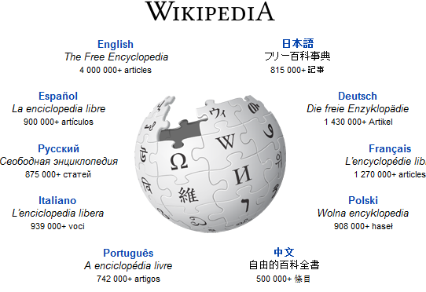
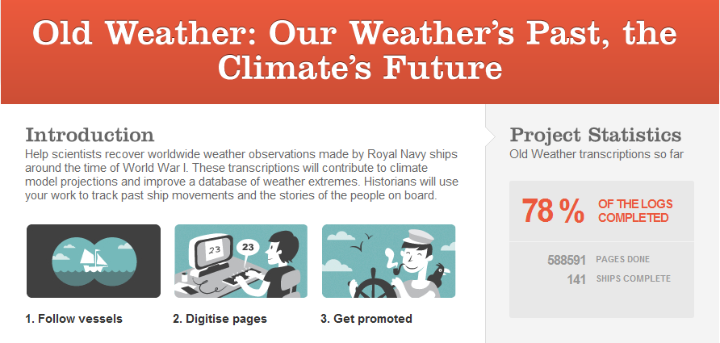
Crowd Sourcing
Citizen Science, birders, genealogists, and music fans
Notes:
If Wikipedia were a book it would be 2.25 million pages long and would take over 123 years to read
Model Earth's climate using wartime ship logs
// information Project Old Weather Category climate Official Site oldweather.org Partners Atmospheric Circulation Reconstructions over the Earth (ACRE), Met Office, Naval-History.Net, National Maritime Museum, JISC, The National Archives Released October 12th 2010 Status active
Help scientists recover worldwide weather observations made by Royal Navy ships around the time of World War I. These transcriptions will contribute to climate model projections and improve a database of weather extremes. Historians will use your work to track past ship movements and the stories of the people on board. Now done and they are off to the artic—over 600,000 people were involved in this project
100,000,000 birder records
Just before 6:00pm Pacific time on 8 August 2012, Liron Gertsman of Vancouver, British Columbia, submitted the 100 millionth observation to eBird. It was of an American Robin; one of 24 species that Liron saw at the Maplewood Conservation Area that day. The director of the Cornell Lab of Ornithology, John Fitzpatrick said, "This is a true milestone in the history of field ornithology and citizen science. The power of so much data is only just beginning to be recognized around the world. I look forward to the time when even 100,000,000 observations seems like a quaint number!

Slide 16
Collections at Scale
From local collection to collective collection
Two examples
  2CUL
  HathiTrust
Essential building blocks

Slide 17


Deep integration of resources, collections,
services, and expertise
Notes:
A transformative and enduring partnership between two major academic research libraries.
Why these 2? Besides our great initials? (Cambridge)
Why the Columbia and Cornell University Libraries?
Shared staffing for Slavic/Eastern Europe, Southeast Asia, Latin America, and South Asia
Coordinated purchasing plan in China
Reciprocal cataloging pilot for Korean and Turkish-language material
New delivery/access agreements
Exploration of system requirements for joint workflow
Assessment of digital preservation gaps
major research libraries
New York state
private Ivy institutions
similar academic characteristics
record of collaboration
record of innovation
budget challenges
will and interest

Slide 18

Interdependent global collections
  Slavic/East European, Southeast Asia, South Asia, Latin America/Iberian studies
  Narrowing the gap between what is produced and what is collected
Enabling prerequisites
Chinese purchasing/shelf-ready plan

Slide 19
Collection Overlap of Columbia
and Cornell Holdings
Cornell
5,857,315
Columbia
5,579,486
3,789,465
65%
2,067,850
37% / 35%
3,511,636
63%

Slide 20

HathiTrust
69 members
10+ M volumes
Overlap with ARL libraries
Digital and print archive plans
Government documents

Slide 21
Operating at Scale
Building the vision
Providing basic building blocks
  Technical, content, data, policy, governance, financial, legal prerequisites
Investing beyond the campus
Engaging third parties
Finding the white space

Slide 22
“If we can take initial steps toward collective action in confronting the key challenges facing collection development, then it will continue to thrive and succeed in the new environment and will ensure that the research library is even more of a cornerstone of scholarship in the new academy. We should aim, I think—we must aim—for nothing less than that.”
Ross Atkinson, 2005

Slide 23

Thank You!

